Slide 1
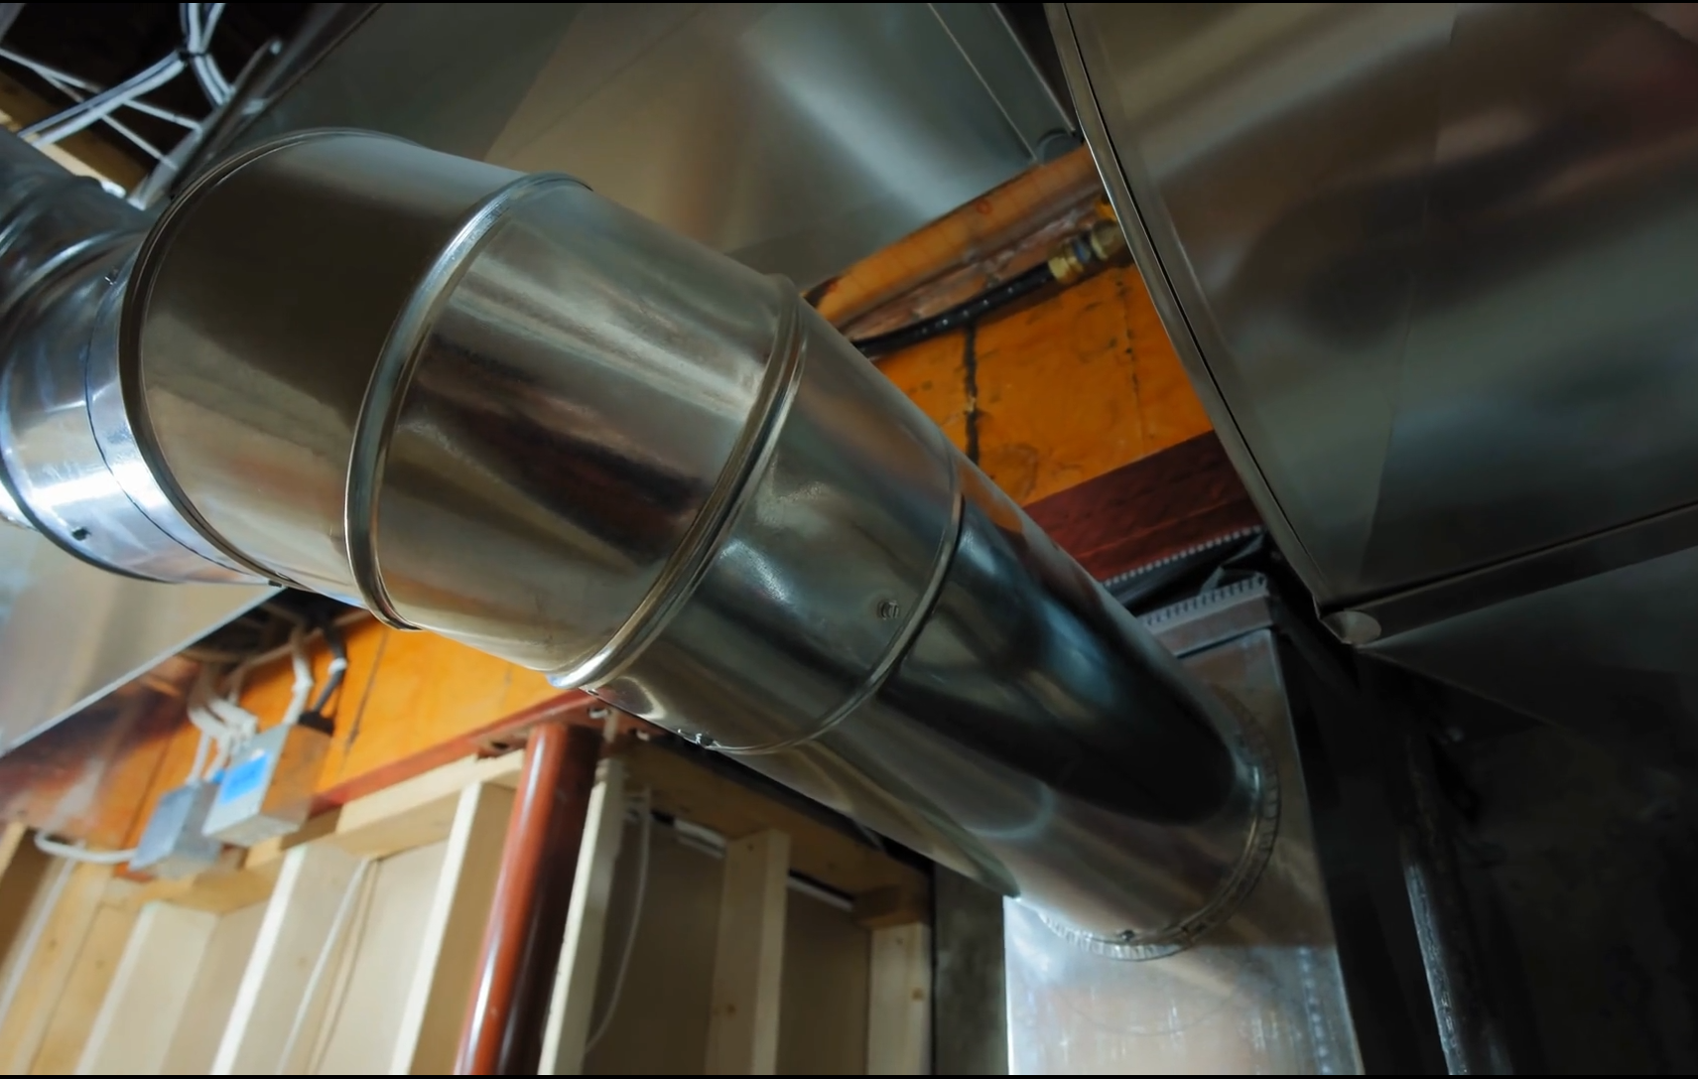

Ducts, Mufflers, and Silencers
Waves in ducts
Tyler Dare

Slide 2
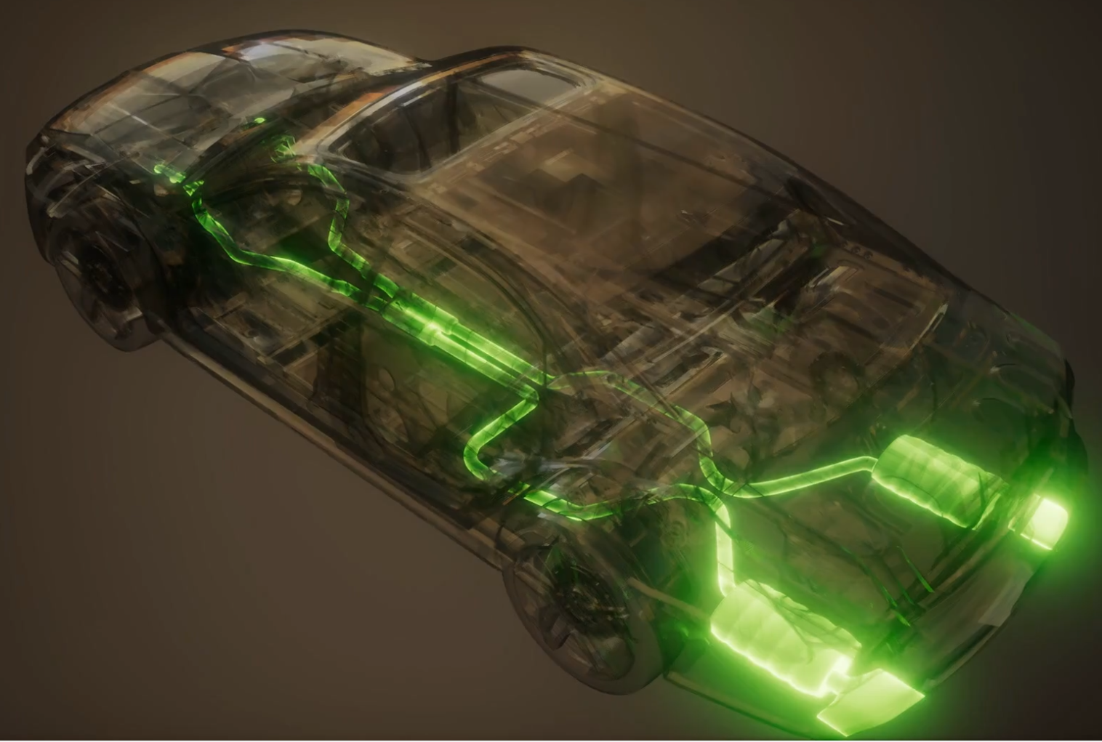
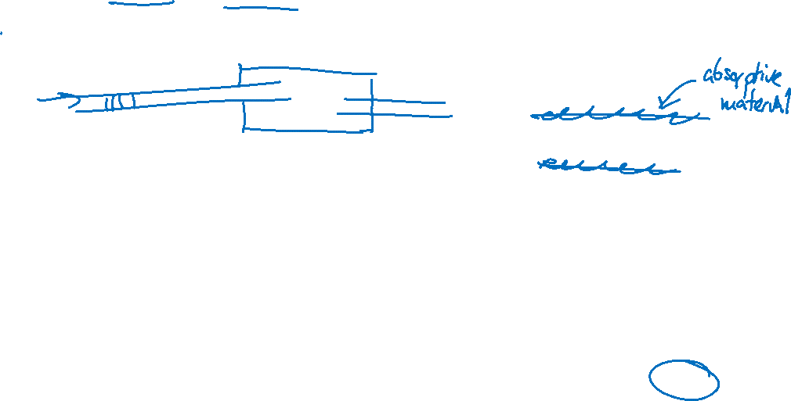
Goal: to be able to design and characterize
Duct systems
Including HVAC ducts and pipes containing water or other fluids
Mufflers
How can changing cross-section and connection details can reduce noise?
Silencers
How effective is lining ducts with absorbing material?

Slide 3
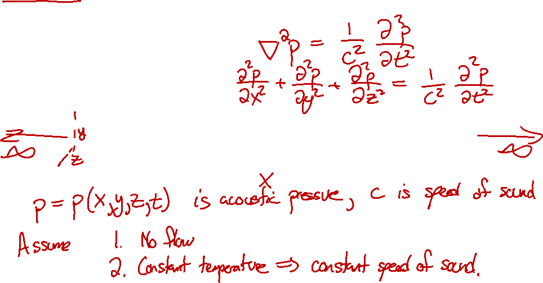
Infinite rectangular duct
Consider an infinitely-long duct with rigid walls. What can we say about acoustic waves inside the duct?
Acoustic wave equation:

Slide 4
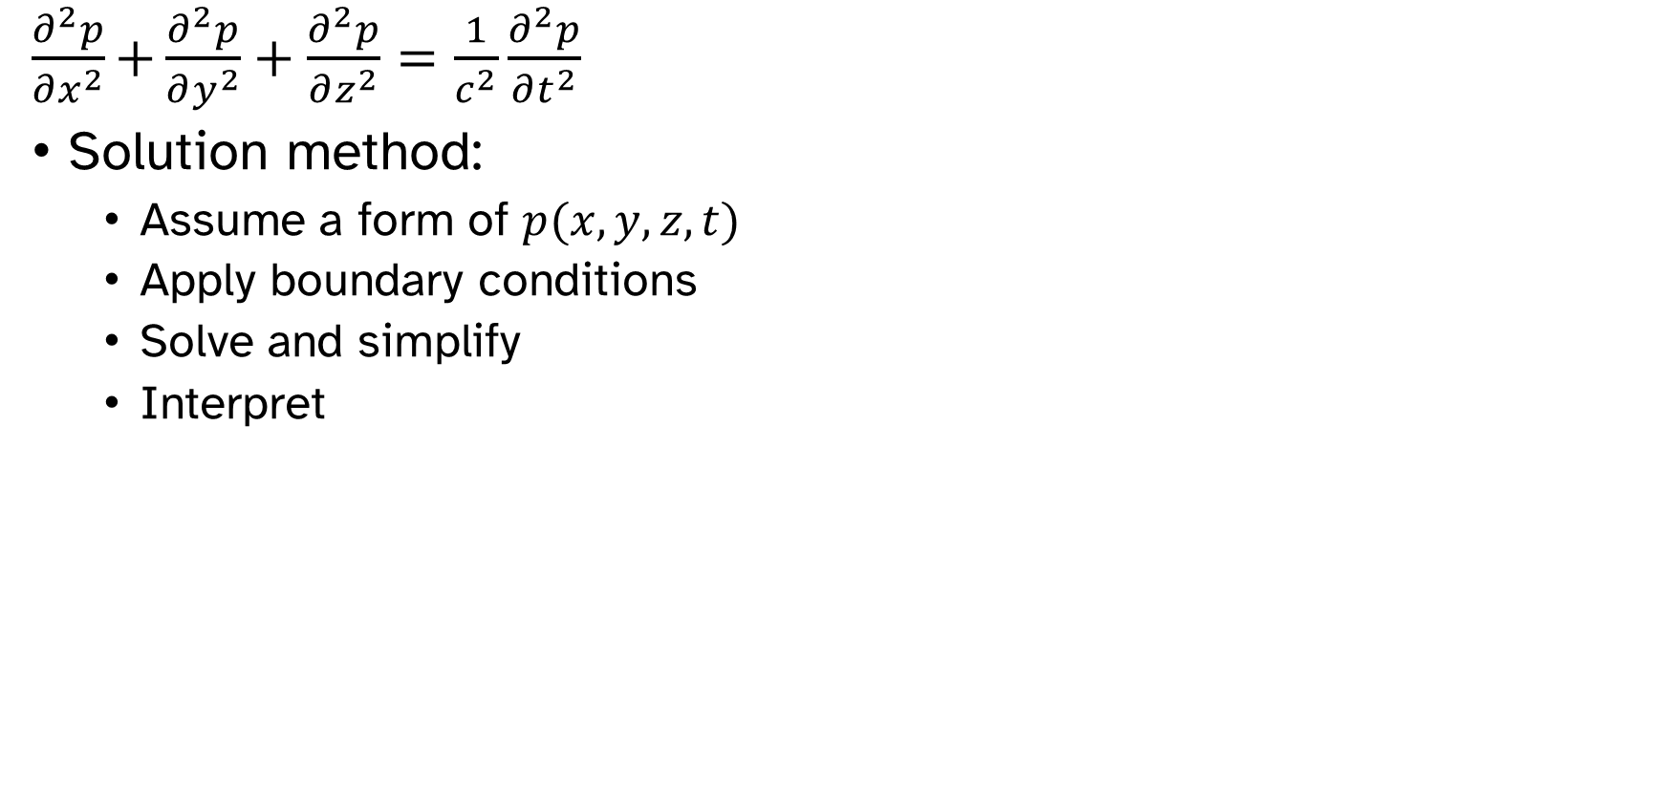
Infinite rectangular duct
$\frac{∂^{2}p}{∂x^{2}}\text{+}\frac{∂^{2}p}{∂y^{2}}+\frac{∂^{2}p}{∂z^{2}}=\frac{1}{c^{2}}\frac{∂^{2}p}{∂t^{2}}$
Solution method:
Assume a form of $p(x,y,z,t)$
Apply boundary conditions
Solve and simplify
Interpret

Slide 5
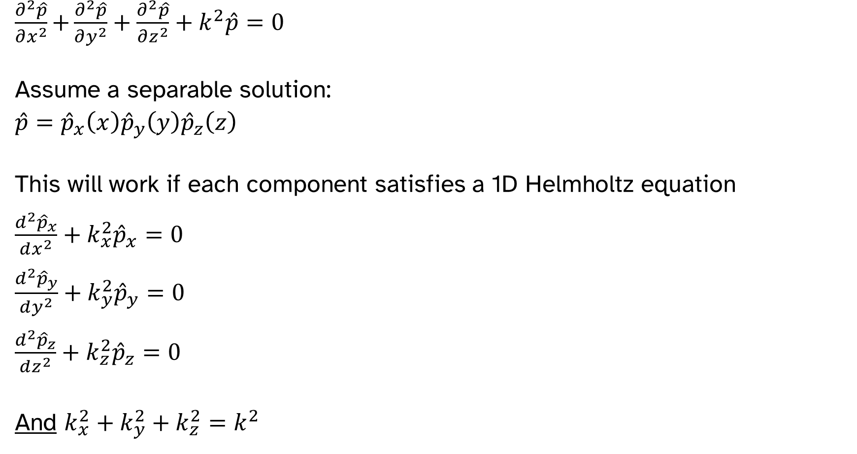
Infinite rectangular duct
$\frac{∂^{2}\hat{p}}{∂x^{2}}\text{+}\frac{∂^{2}\hat{p}}{∂y^{2}}+\frac{∂^{2}\hat{p}}{∂z^{2}}+k^{2}\hat{p}=0$
Assume a separable solution:
$\hat{p}={\hat{p}}_{x}\left(x\right){\hat{p}}_{y}\left(y\right){\hat{p}}_{z}\left(z\right)$
This will work if each component satisfies a 1D Helmholtz equation
$\frac{d^{2}{\hat{p}}_{x}}{dx^{2}}+k_{x}^{2}{\hat{p}}_{x}=0$
$\frac{d^{2}{\hat{p}}_{y}}{dy^{2}}+k_{y}^{2}{\hat{p}}_{y}=0$
$\frac{d^{2}{\hat{p}}_{z}}{dz^{2}}+k_{z}^{2}{\hat{p}}_{z}=0$
And $k_{x}^{2}+k_{y}^{2}+k_{z}^{2}=k^{2}$

Slide 6
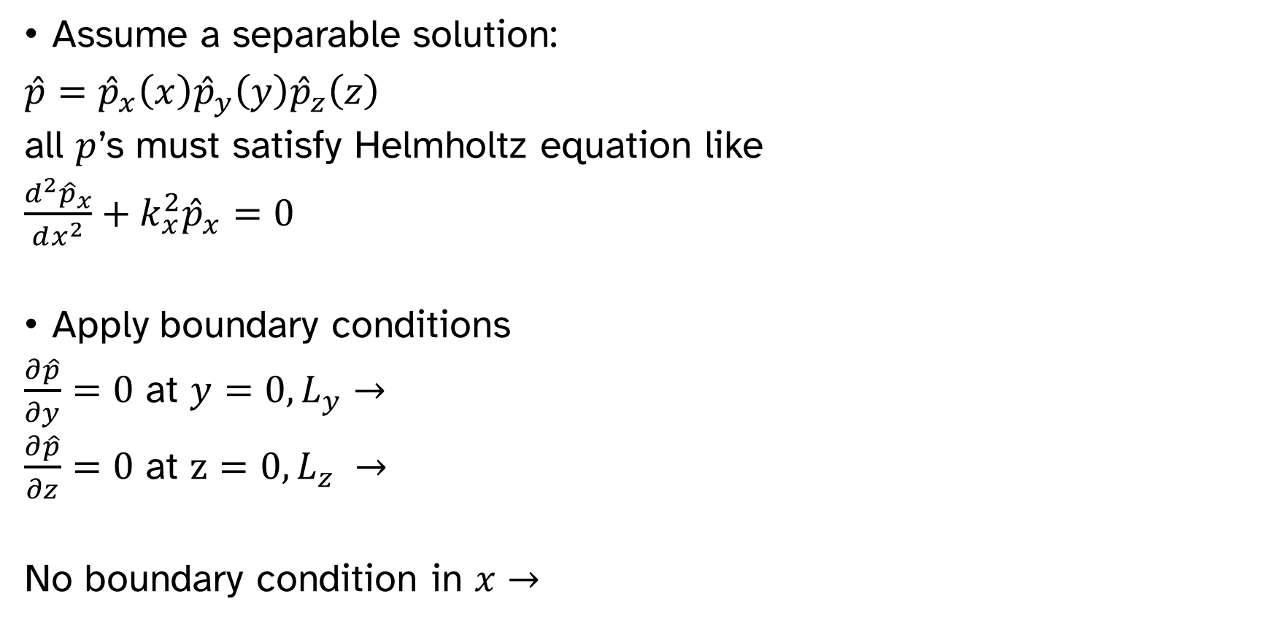
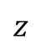
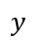
Infinite rectangular duct
Assume a separable solution:
$\hat{p}={\hat{p}}_{x}\left(x\right){\hat{p}}_{y}\left(y\right){\hat{p}}_{z}\left(z\right)$
all $p$’s must satisfy Helmholtz equation like
$\frac{d^{2}{\hat{p}}_{x}}{dx^{2}}+k_{x}^{2}{\hat{p}}_{x}=0$
Apply boundary conditions
$\frac{∂\hat{p}}{∂y}=0$ at $y=0, L_{y}$ $→$
$\frac{∂\hat{p}}{∂z}=0$ at $z=0, L_{z} →$
No boundary condition in $x→$
$$z$$
$$y$$

Slide 7
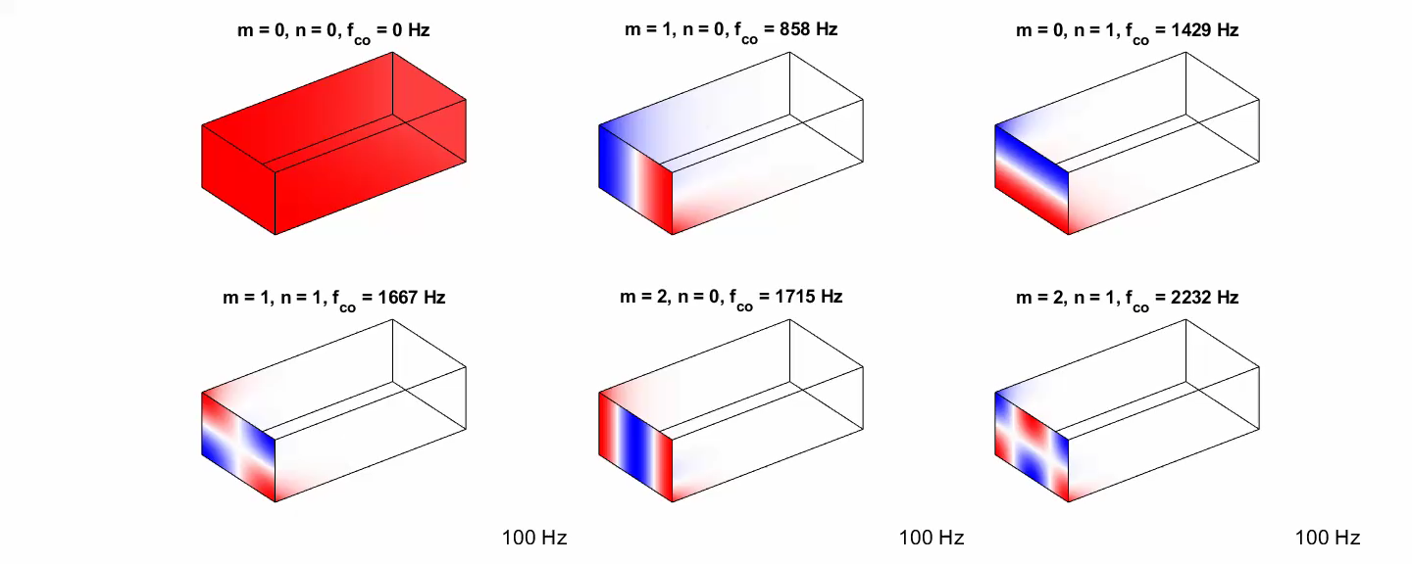
Duct mode shapes

Slide 8
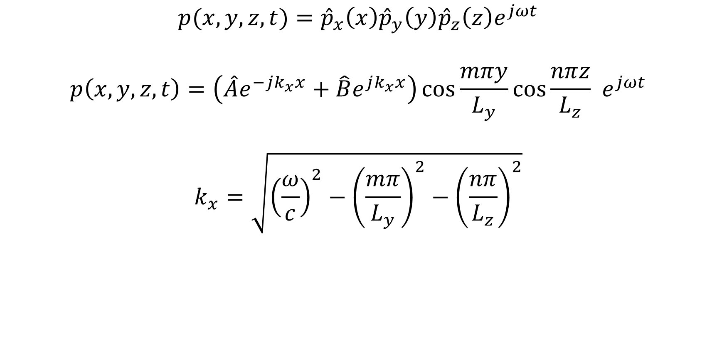
Infinite rectangular duct
$$p(x,y,z,t)={\hat{p}}_{x}\left(x\right){\hat{p}}_{y}\left(y\right){\hat{p}}_{z}\left(z\right)e^{jωt}$$
$$p\left(x,y,z,t\right)=\left(\hat{A}e^{−jk_{x}x}+\hat{B}e^{jk_{x}x}\right)\cos{\frac{mπy}{L_{y}}}\cos{\frac{nπz}{L_{z}}} e^{jωt}$$
$$k_{x}=\sqrt{{\left(\frac{ω}{c}\right)}^{2}−{\left(\frac{mπ}{L_{y}}\right)}^{2}−{\left(\frac{nπ}{L_{z}}\right)}^{2}}$$

Slide 9
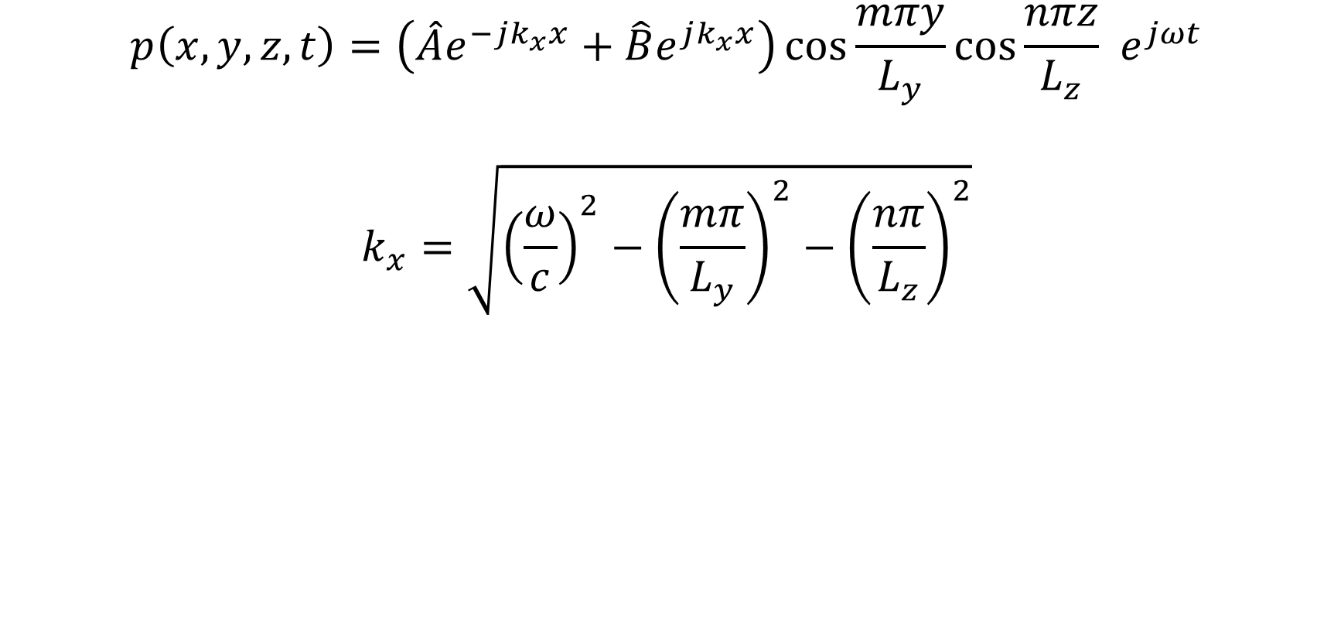
Cut-on frequency
$$p\left(x,y,z,t\right)=\left(\hat{A}e^{−jk_{x}x}+\hat{B}e^{jk_{x}x}\right)\cos{\frac{mπy}{L_{y}}}\cos{\frac{nπz}{L_{z}}} e^{jωt}$$
$$k_{x}=\sqrt{{\left(\frac{ω}{c}\right)}^{2}−{\left(\frac{mπ}{L_{y}}\right)}^{2}−{\left(\frac{nπ}{L_{z}}\right)}^{2}}$$

Slide 10
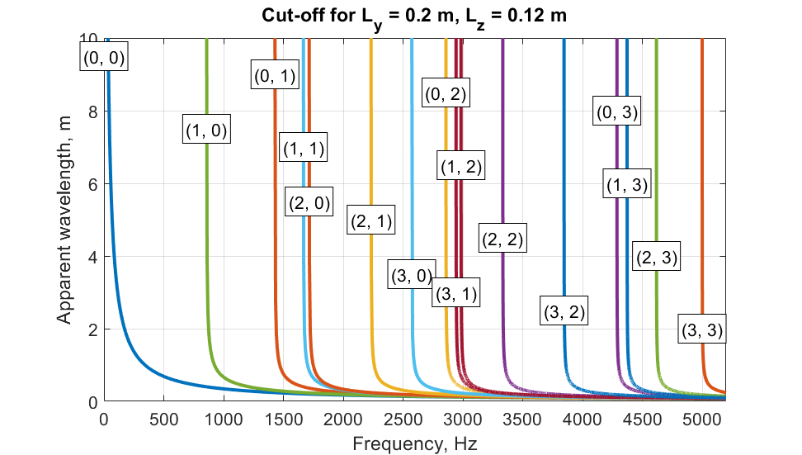
Cut-on frequency

Slide 11
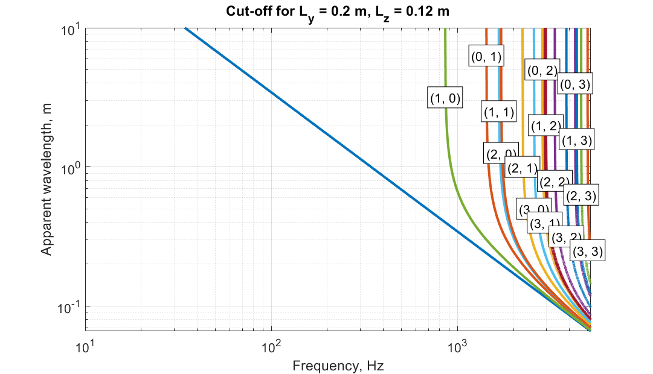
Cut-on frequency

Slide 12
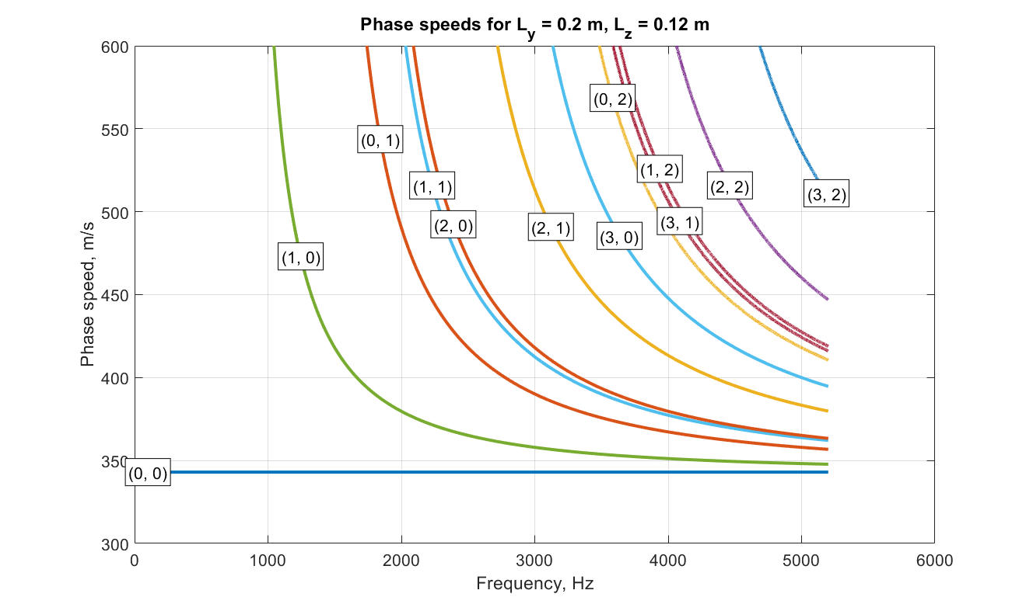
Cut-on frequency

Slide 13
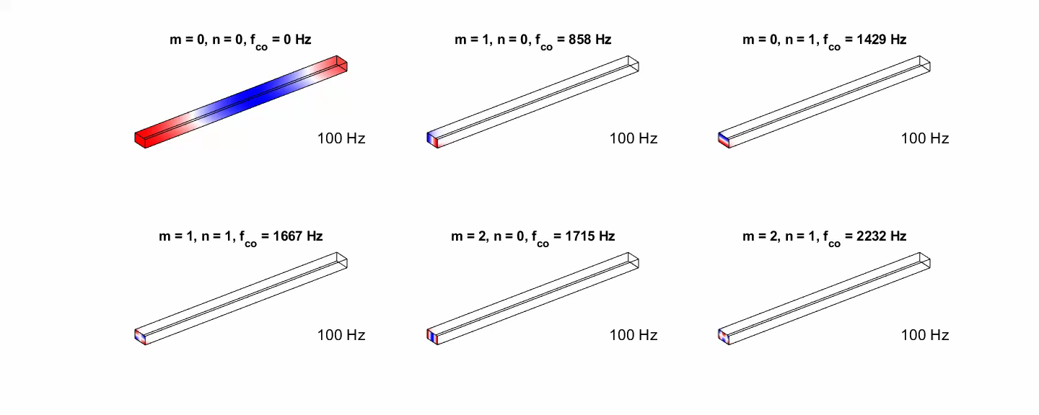
Cut-on of duct modes

Slide 14

Now it gets complicated
What if the duct changes size?
How can we model losses?
How do we deal with flow?
What happens if the temperature changes?
What if the cross section isn’t a rectangle?

Slide 15
Simplification allows complexity
Major assumption:
Frequency is low enough so that higher-order modes do not cut on.
Benefits:
3D acoustics becomes 1D
Cross-section shape doesn’t matter
Acoustic field can be described by two variables:

Slide 16
